Slide 1

Zend Framework 2.0
Juozas “Joe” Kaziukėnas http://juokaz.com / juozas@juokaz.com / @juokaz

Slide 3
Who is this guy?
Juozas Kaziukėnas
People prefer to call me Joe
Lives in Edinburgh, UK
Runs Web Species Ltd. (still can write code)
Speaker in PHP conferences all over the world
Open source developer (Zend Framework, Doctrine etc.)
More info http://juokaz.com and @juokaz

Slide 4
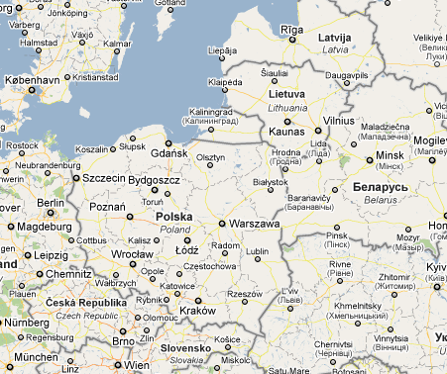
The map
Now lives here
From Vilnius
We are here

Slide 5


http://webspecies.co.uk

Slide 6

Zend framework

Slide 7

Are you A ZF developer?

Slide 8

If you are not…

Slide 9
Zend framework

Slide 10
Zend framework
Journey from October 2005 to today
March 2006 – 0.1
July 2007 – 1.0
Today – 1.11
Massive amounts of (high quality) code
The most popular PHP framework
Developers
Business

Slide 11

Problems

Slide 12

Magic

Slide 13
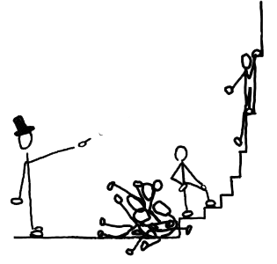
Learning curve

Slide 14
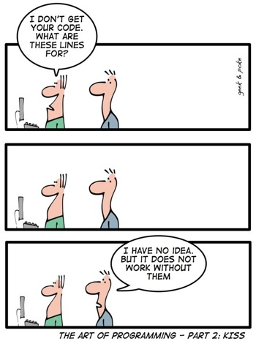
Learning curve

Slide 15

COnflicting

Slide 16
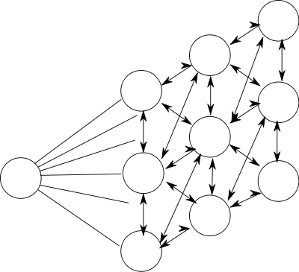
Still coupled

Slide 17

Most importantly…

Slide 18

Slow*
Don’t forget the *

Slide 19

Zend framework 2.0

Slide 20
The primary thrust of ZF 2.0 is to make a more consistent, well-documented product, improving developer productivity and runtime performance.
Zend Framework 2.0

Slide 21
Zend framework 2.0
Development on Git
CLA is needed though
PHP 5.3 only
Old code converted to namespaced
Improve, not start from scratch*

Slide 22

Trends in PHP 2011

Slide 23
Milestones
Autoloading & Plugin loading
Exceptions
MVC
Testing
Documentation
Internationalization

Slide 24
AutoloadING
include_path sucks
Use maps
Namespace => Path
Class name => Path
ZF2 ships with class name paths for all components
Build your own on deployment
Notes:
Namspace path – 40% percent gain
Class name path – 150% percent gain

Slide 25
Plugins
No more magic
Multiple flavors
Plugin class => alias
Fast

Slide 26
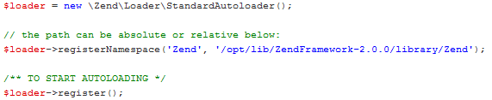
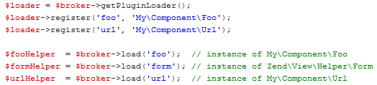
Loader examples

Slide 27
Exceptions
Tree of exceptions in current ZF
Exception -> Zend_Exception -> Zend_Acl_Exception -> etc..
Using SPL exceptions
Component level interfaces
Exceptions sub-namespace in component

Slide 28
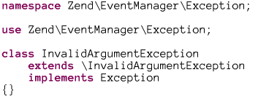
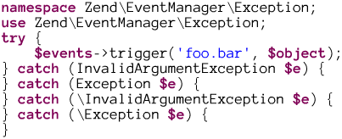
Exceptions example

Slide 29
MVC
Many flavors, interface based
Modules done right
Controllers as services
Form & View cleanup

Slide 30
Dependency injection
Zend_Registry
Service Locator
Dependency injection container
Java
Type hinting in application, plus easier testing

Slide 31
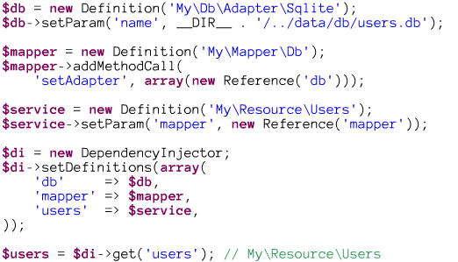
DIC example

Slide 32

At least 200% faster

Slide 33
More…
Documentation
Configuration
Events
Interfaces
Community Review team
Beer (?)

Slide 34

When?

Slide 35
When?
MVC milestone by the end of May
PR release following MVC completion
Beta in summer
Stable by the end of this year

Slide 36
Let’s rock
Work in progress
MVC milestone in progress
Will be faster, easier and overall better
Final release this year
Contribute!

Slide 37
Thank you!
Please leave feedback http://joind.in/3202
Contact me on:
http://juokaz.com
juozas@juokaz.com
Twitter: @juokaz
* Images from flickr.com and images.google.com

